Slide 1


Virtual Facilitation Toolbox: part 2
Polls and wordclouds – Mentimeter and Slido
Notes:
12.03

Slide 2

What we will cover today
- running big virtual meetings or events
- tools for engagement with larger groups
- Q&A
Notes:
12.05

Slide 3

Breakout room discussion
Introduce yourselves
Share your experiences of a good online event you’ve been to – what made it engaging?
Notes:
12.07
6 mins

Slide 4

Large virtual events and meetings
- design
- participants
- accessibility
Notes:
12.13
Design – don’t expect a conversation in a group of more than 7, use breakout rooms as much as possible, never do death by feedback, 7 minute rule
Participants – easier to lose people, offer breaks and keep people off emails
Accessibility – be aware of the chat, consider different ways of contributing

Slide 5

A disclaimer about virtual facilitation tools
Notes:
12.15

Slide 6

Polls and wordclouds

Slide 7

Why use polls and wordclouds?
- quick insight from the room
- engage people in the topic
- gather questions
- more visual and participatory
Notes:
12.17

Slide 8
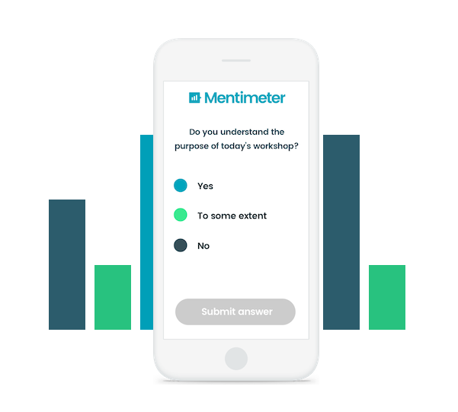
Mentimeter
Free (2 questions) and easy to use
Similar to other websites i.e. Slido
Notes:
12.20

Slide 9
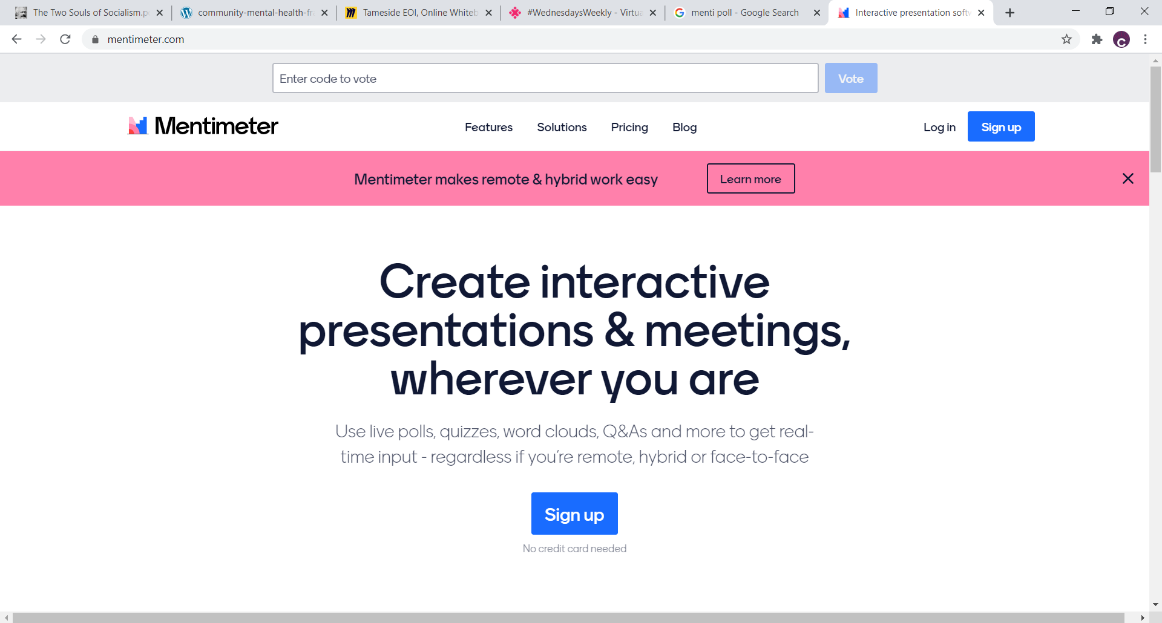
Notes:
Only need name, email and password to make an account

Slide 10
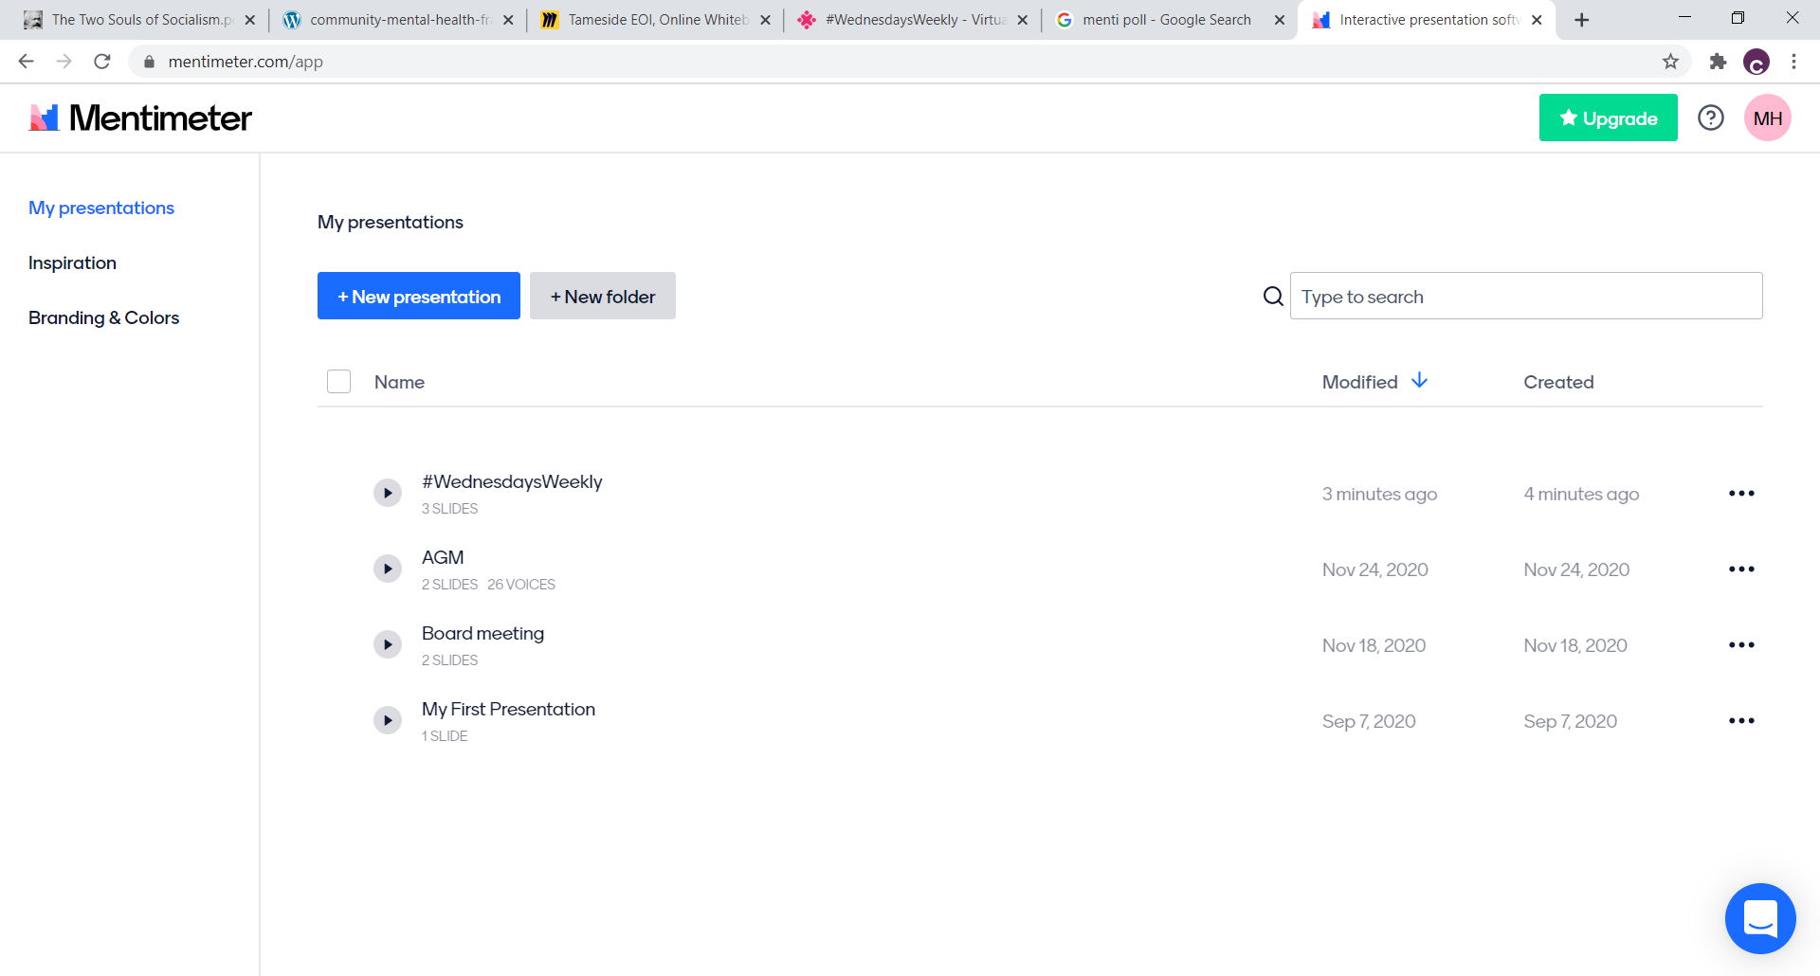

Slide 11
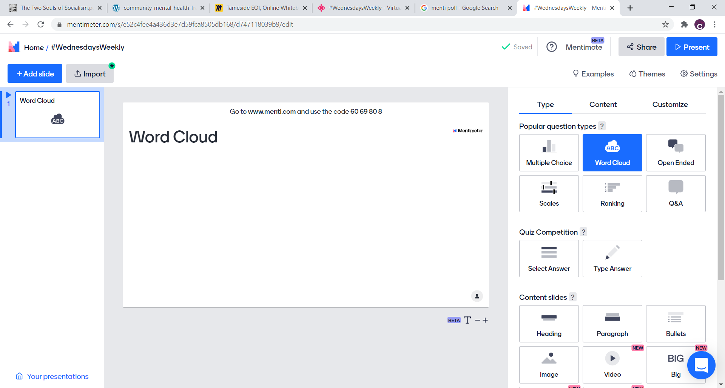

Slide 12
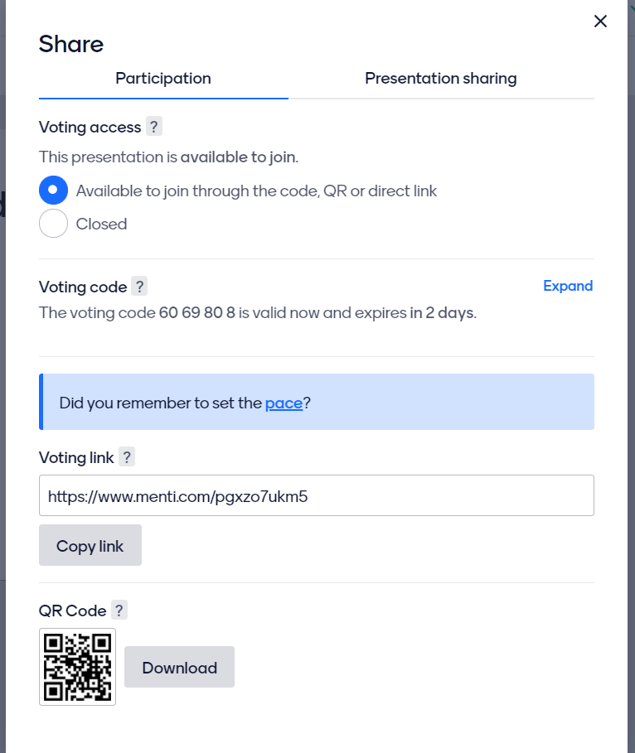

Slide 13
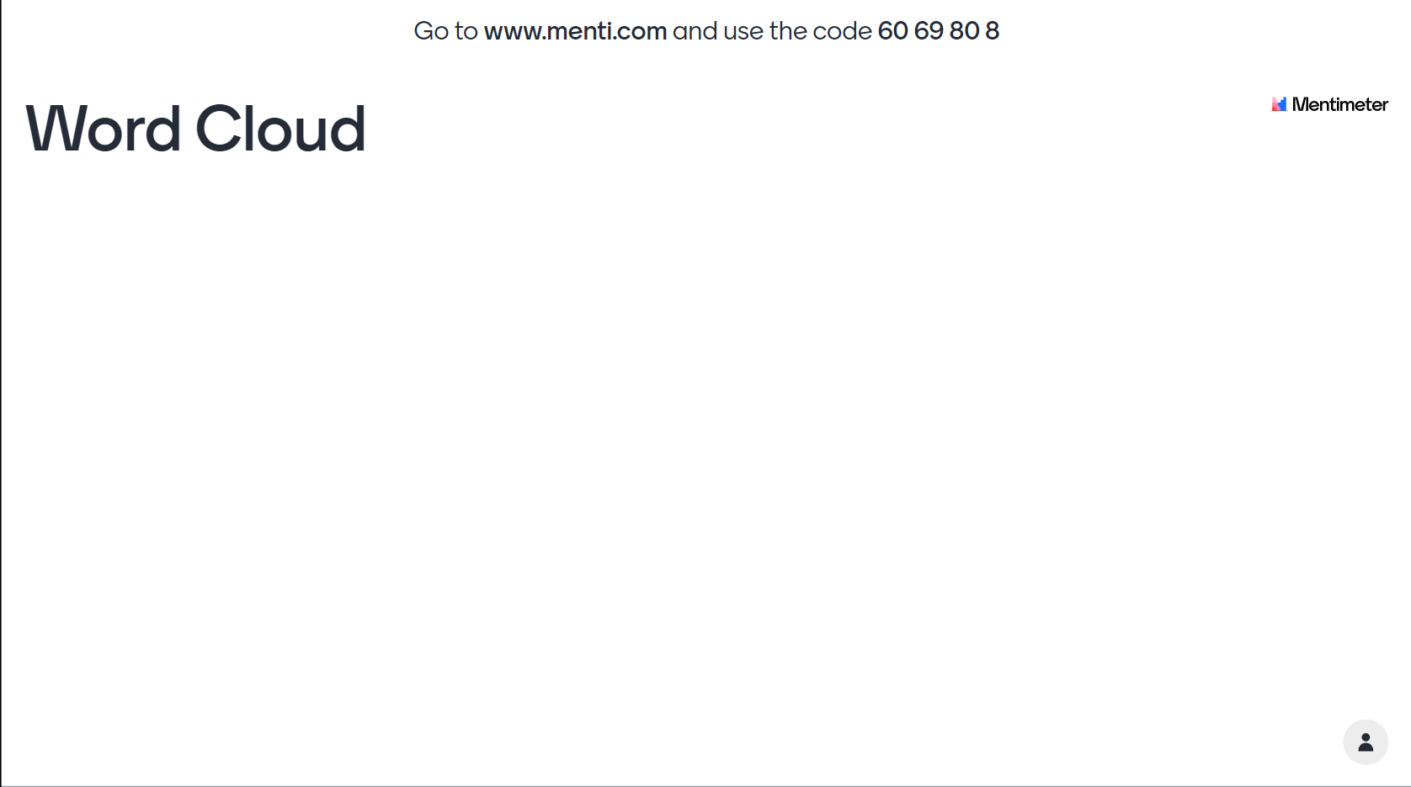

Slide 14
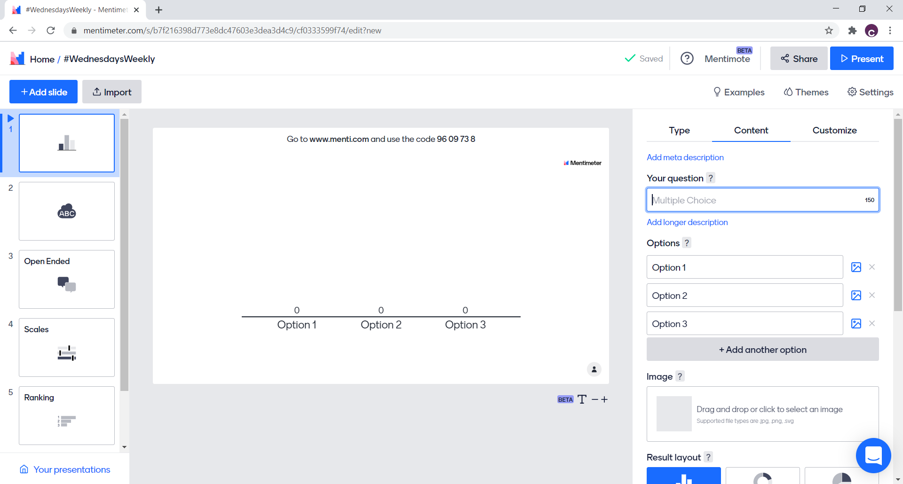
Notes:
Icebreaker / temp check
i.e. could ask what org/sector people are from, how they got to the event, or something silly

Slide 15
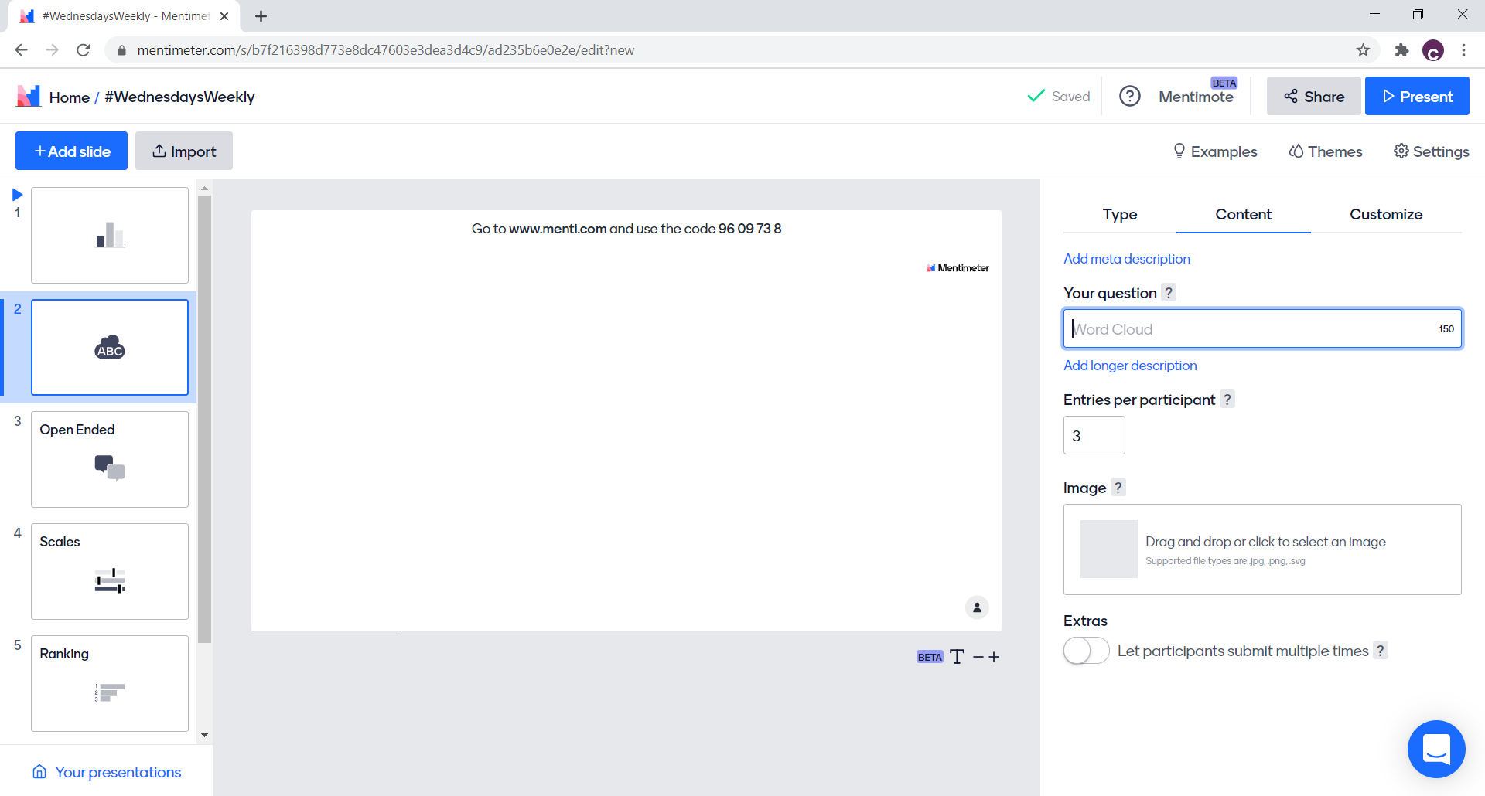
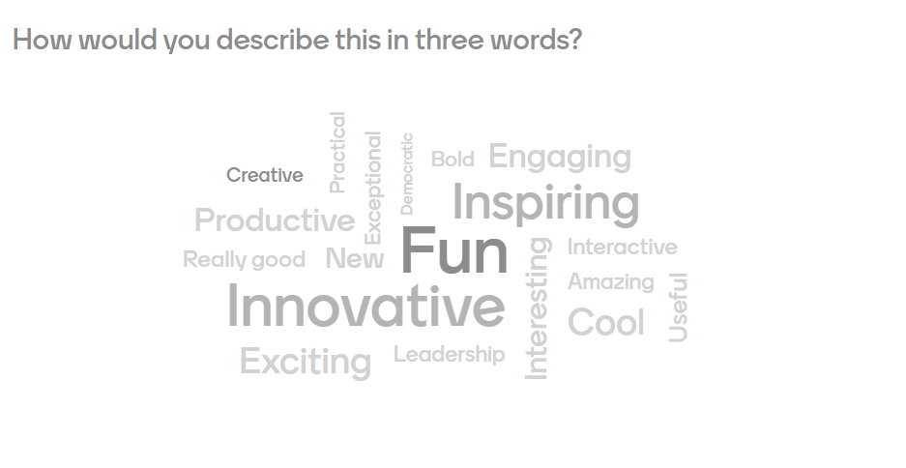
Notes:
Builds up as you go
Shared values or understanding of a topic
Good for emotions

Slide 16
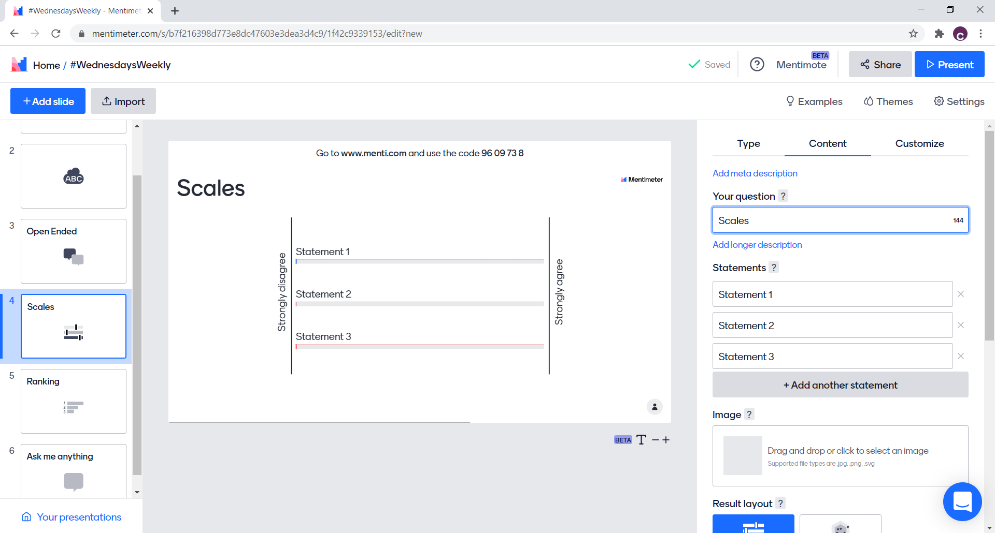
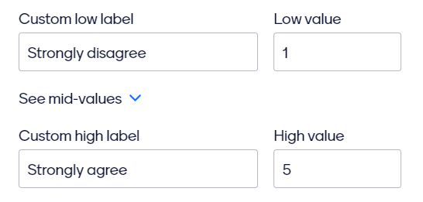
Notes:
Gathering opinions about something
Could be hard/easy, important/not important, agree/disagree

Slide 17
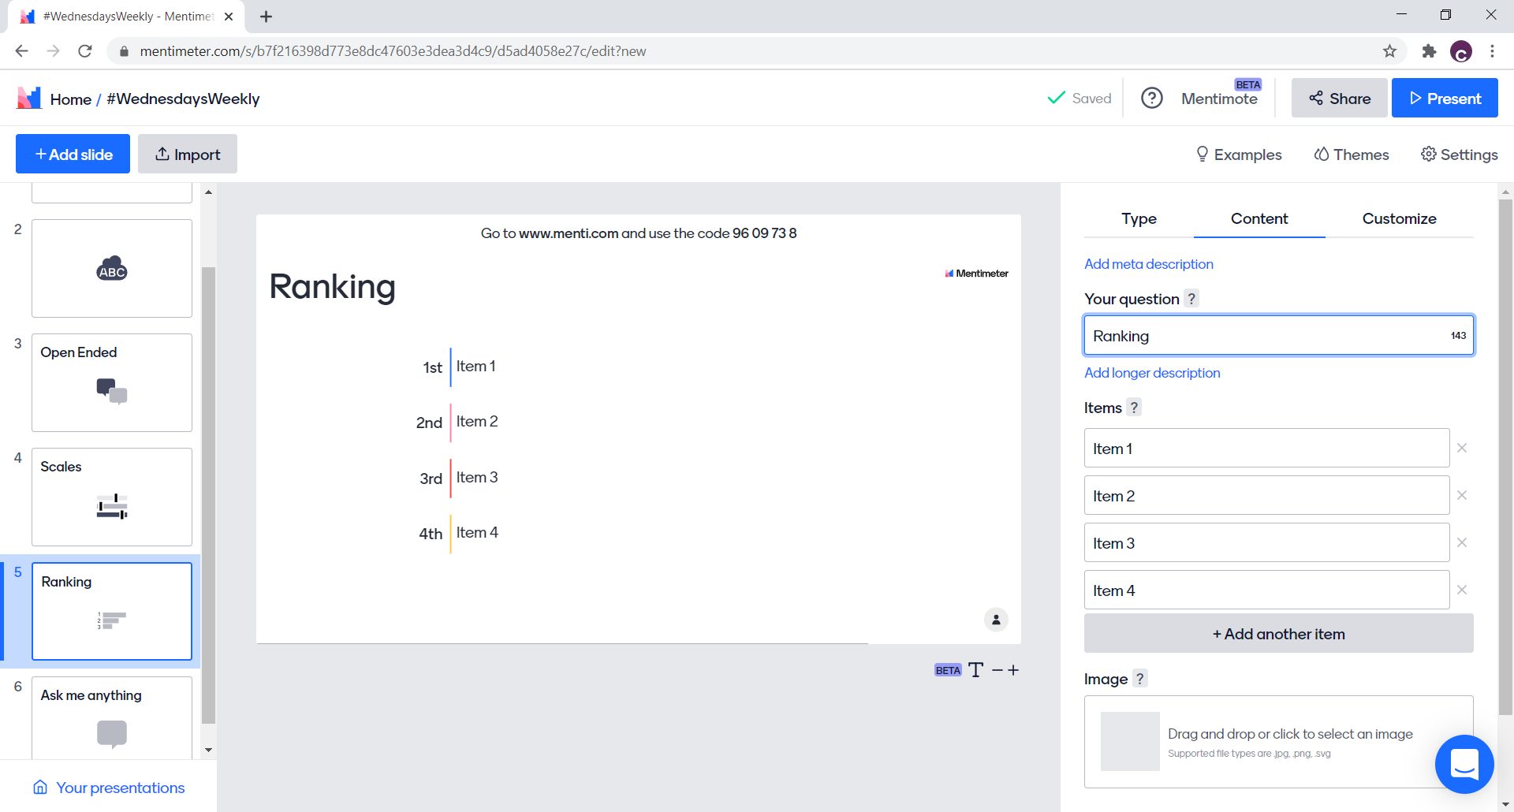
Notes:
Prioritising as a group

Slide 18
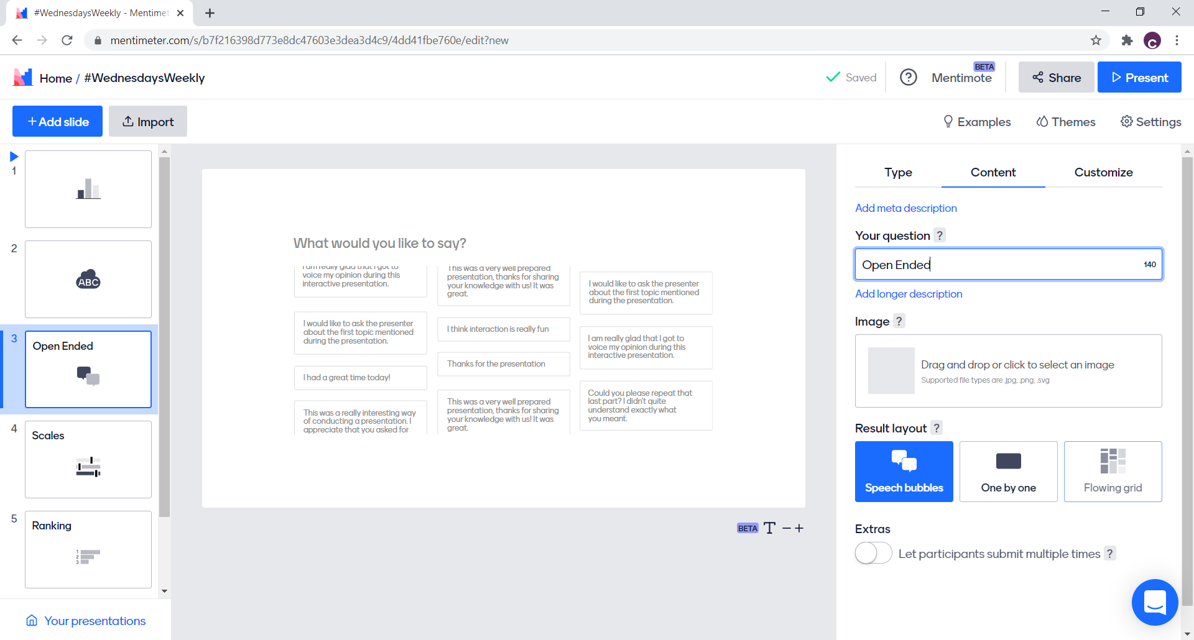
Notes:
Q&A or gathering examples from the room

Slide 19

Let’s have a go!
www.menti.com
Code: 96 09 73 8

Slide 20

  Questions?
Notes:
12.55

Slide 21
Week 3 – creative uses of breakout rooms
Week 4 – collaborative note taking
Week 5 – virtual facilitation clinic
Links to sign up - https://www.actiontogether.org.uk/wednesdaysweekly
Virtual Facilitation Toolbox – the series

Slide 22

www.actiontogether.org.uk
0161 339 2345 info@actiontogether.org.uk @WeActTogether

