Slide 1

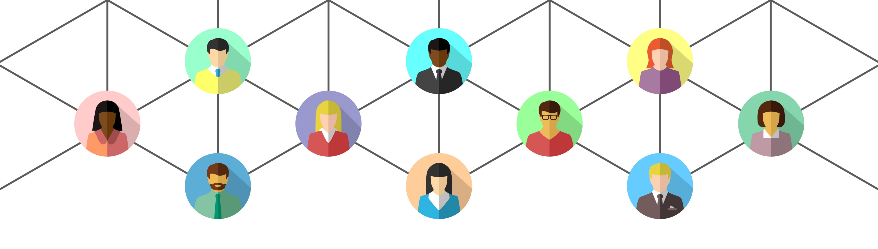
Virtual Facilitation Toolbox: part 4
Polls and wordclouds – GoogleDocs and Slides
Notes:
12.03

Slide 2

What we will cover today
- collaborative note taking
- tools for gathering insight from breakout rooms
- Q&A
Notes:
12.05

Slide 3
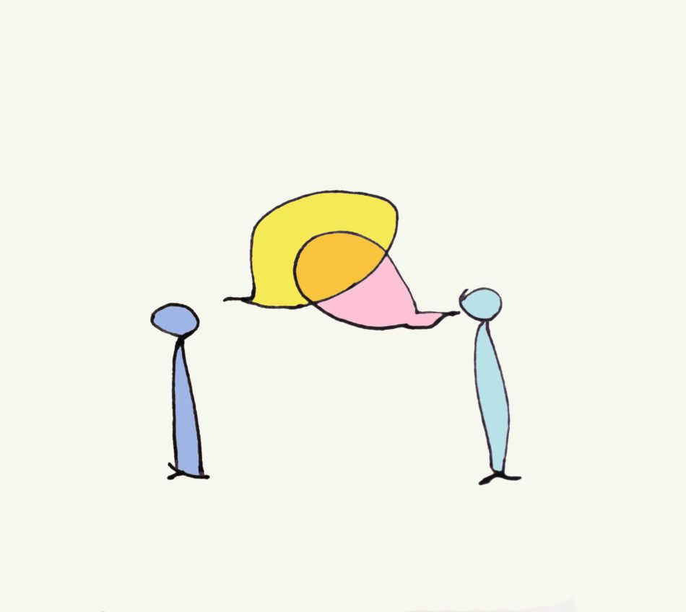
Breakout room discussion
Introduce yourselves
Have you tried any facilitation tools recently (from the training series or not)? How did it go?
Notes:
12.07
12 mins

Slide 4

Collaborative note taking
- design
- accessibility
Notes:
12.13
Design – everything you plan in a meeting should be to get you closer to the overall aims of the session, 40-20-40 rule, gets more complicated in really big meetings
Accessibility – the most accessible of all, a platform most people are used to

Slide 5


Google Docs and Slides

Slide 6

Why collaborative note taking?
- people feel ownership of their words
- record what happens in breakout rooms
- speed up feedback to the room
Notes:
12.17

Slide 7
Google Slides
Free
You need a google account (but can make one with your work email and a password)
Notes:
12.20

Slide 8
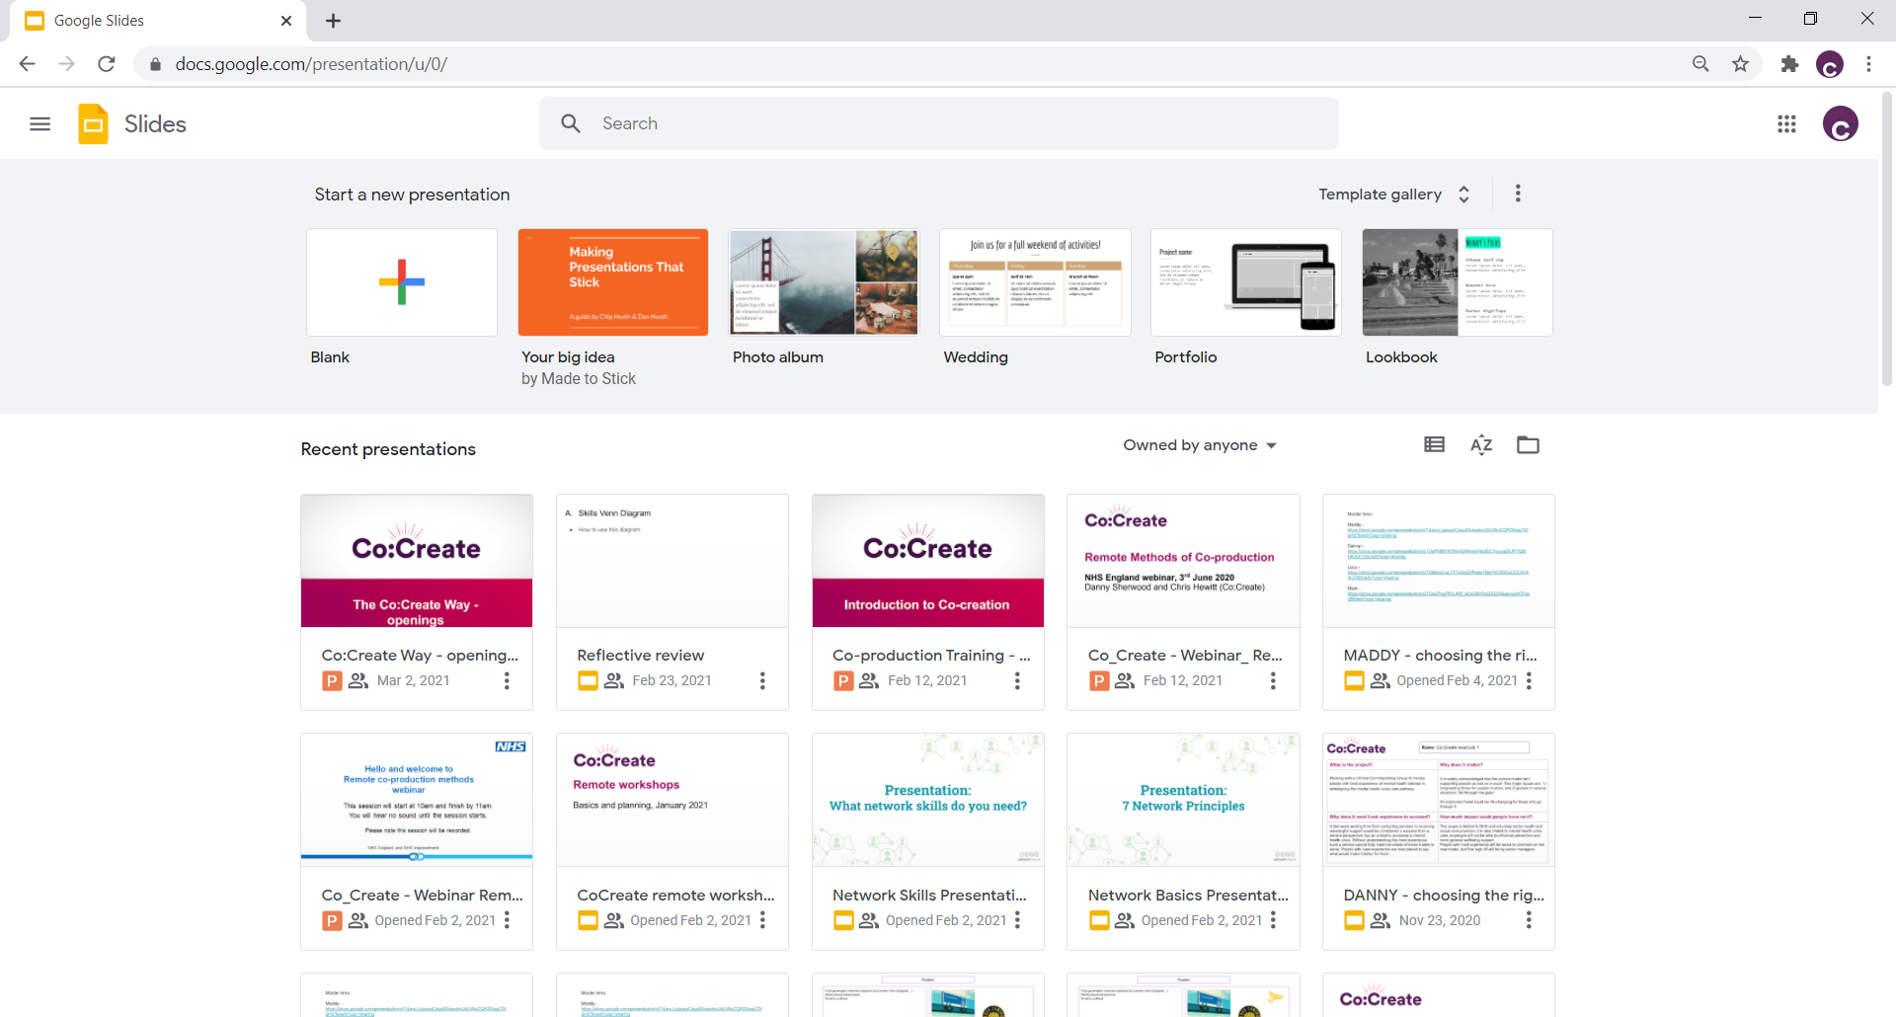

Slide 9
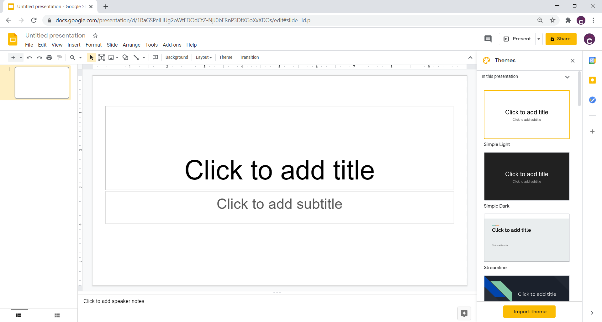

Slide 10
Notes:
Name before sharing

Slide 11
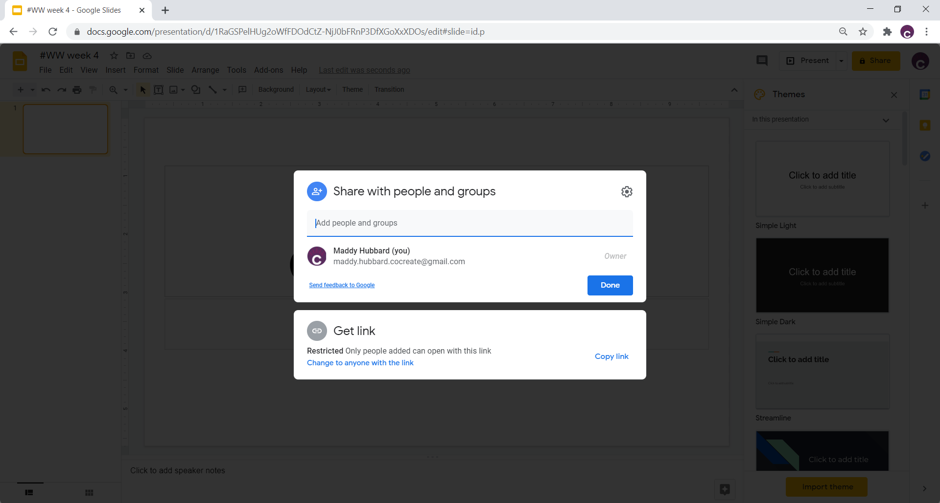

Slide 12
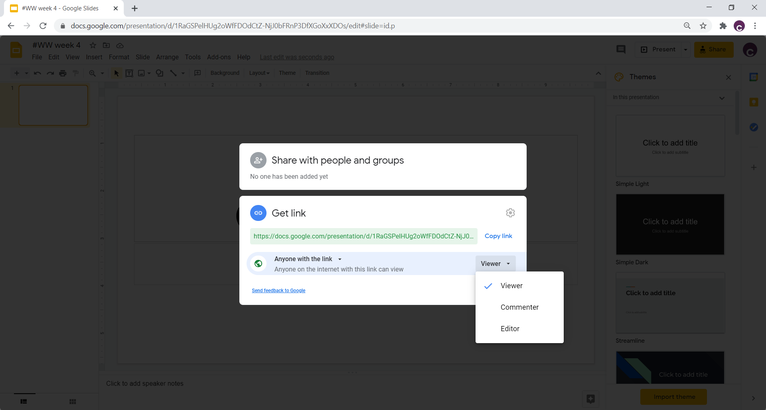

Slide 13
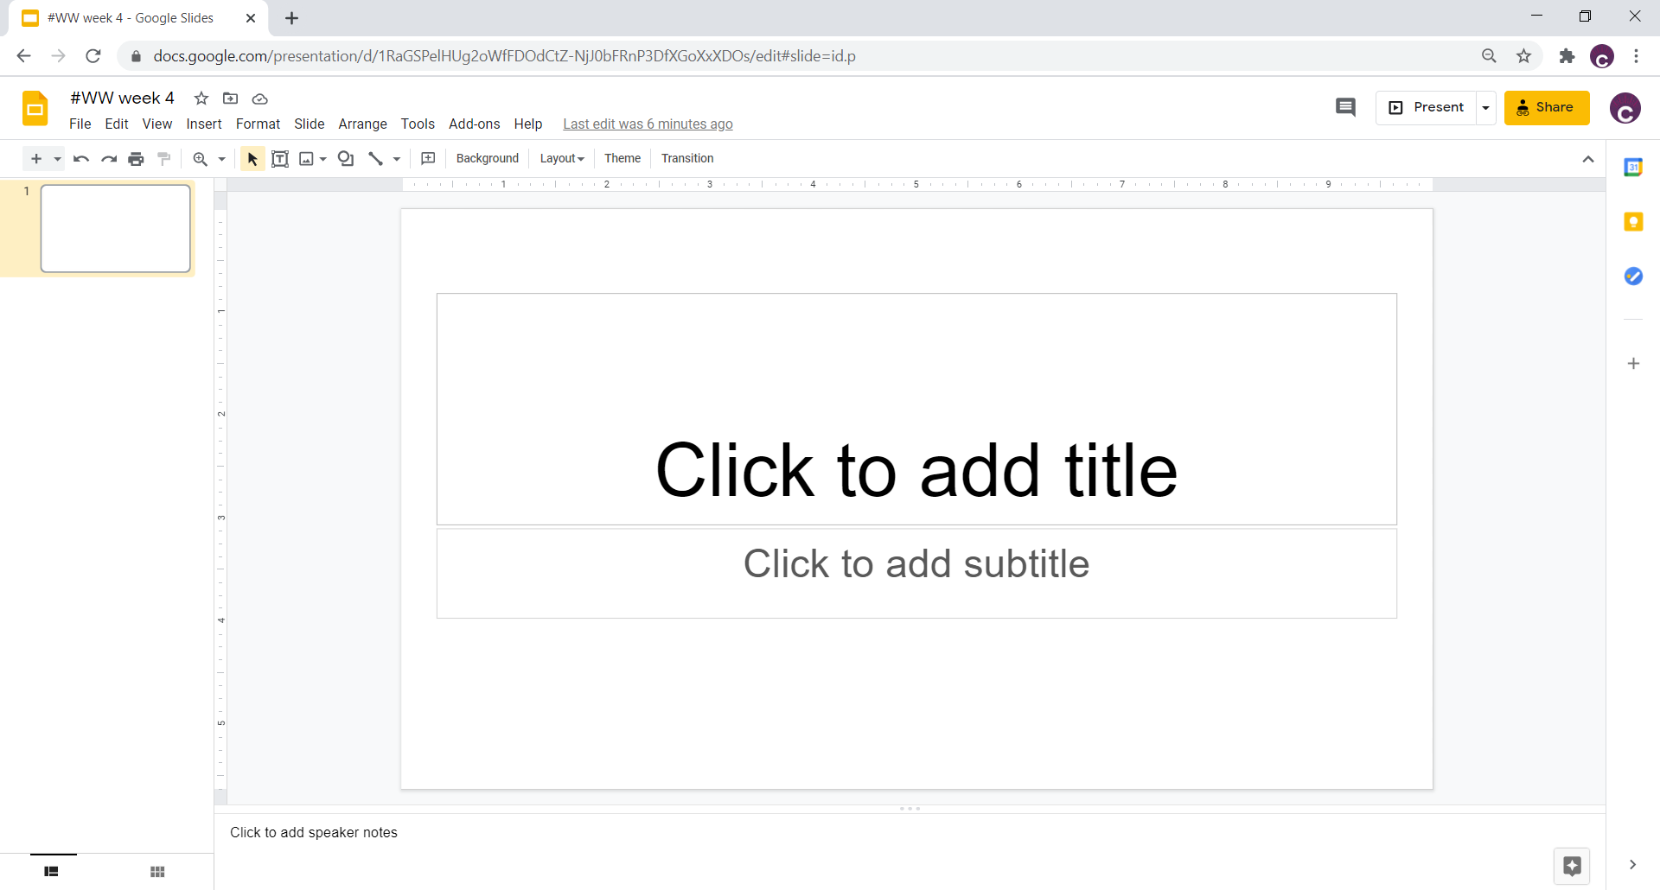

Slide 14
Some ways to use Slides
Breakout rooms
Introduction exercises
Simple version of Miro/Jamboard
Notes:
12.20

Slide 15
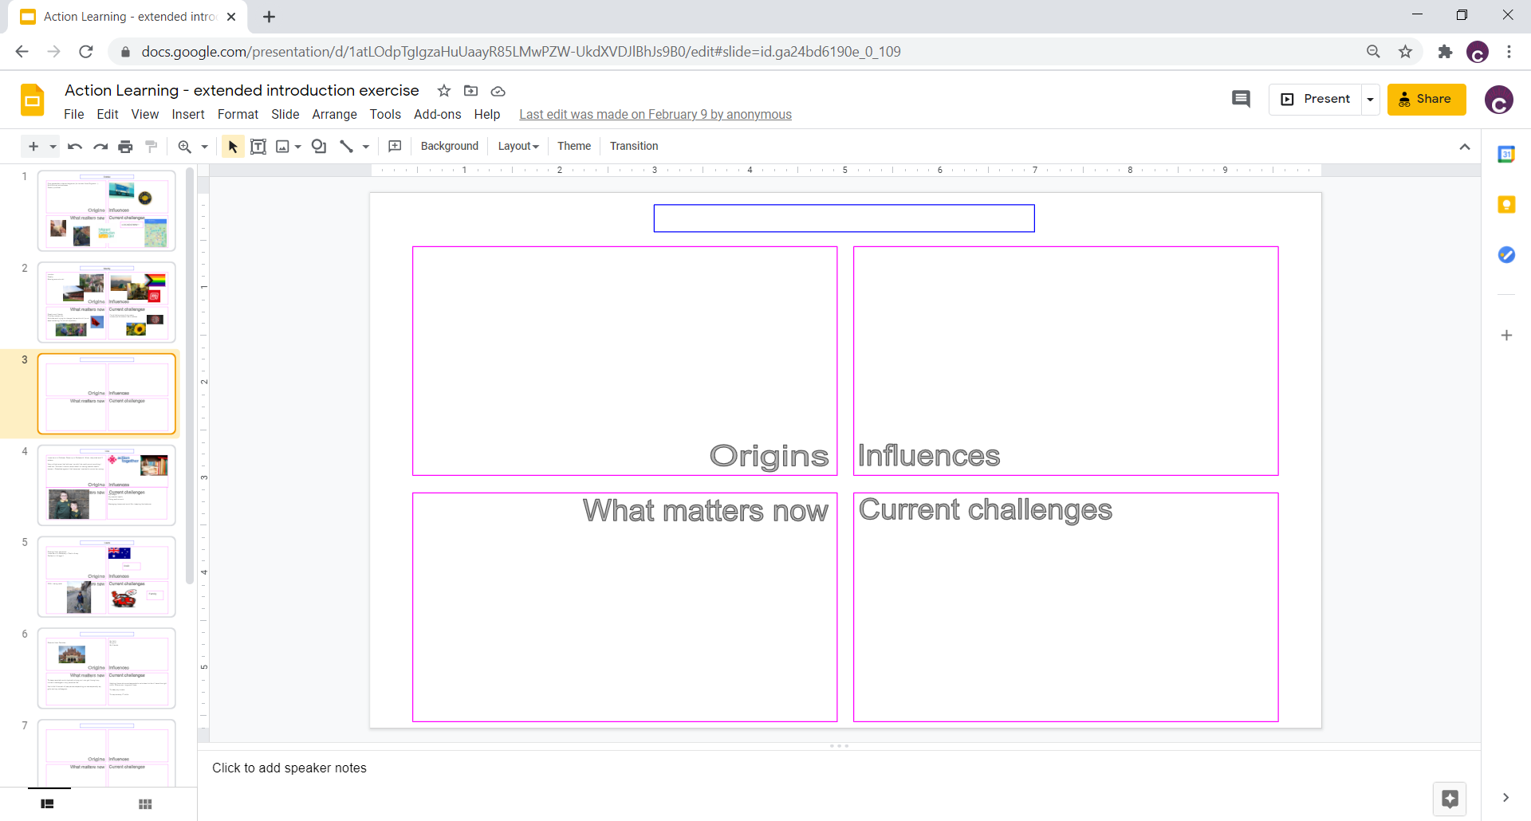

Slide 16
Let’s have a go!
Notes:
Share a link in the chat to the slides
Choose the slide with your breakout room number on it
“Share your experiences of virtual facilitation”
10 mins
Come back and reflect -

Slide 17
Google Docs
Free
You need a google account (but can make one with your work email and a password)
Notes:
12.20

Slide 18
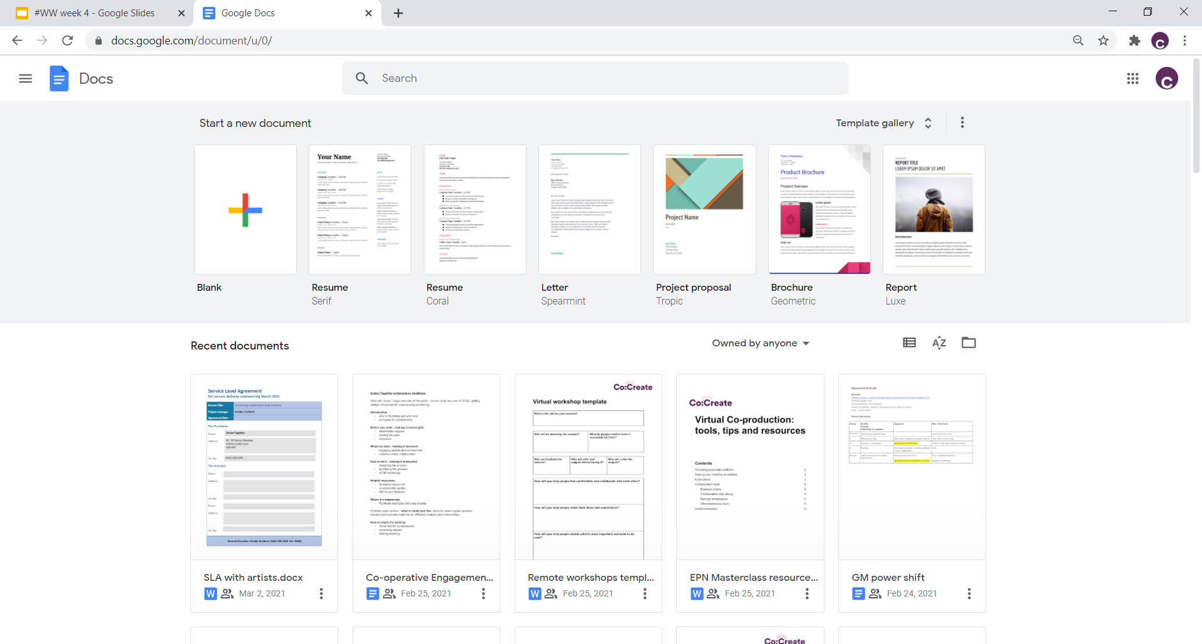

Slide 19
Some ways to use Docs
Nominate a scribe to take minutes
Make a group agreement
Collect feedback/ideas before or after the meeting
Notes:
12.20

Slide 20
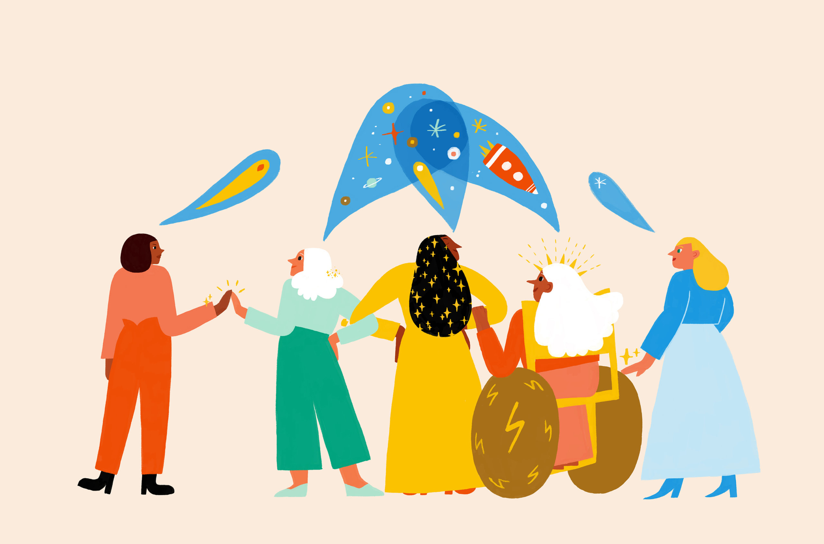
  Questions?
Notes:
12.55

Slide 21
Week 5 – virtual facilitation clinic
Links to sign up - https://www.actiontogether.org.uk/wednesdaysweekly
Virtual Facilitation Toolbox – the series

Slide 22

www.actiontogether.org.uk
0161 339 2345 info@actiontogether.org.uk @WeActTogether

