Slide 1

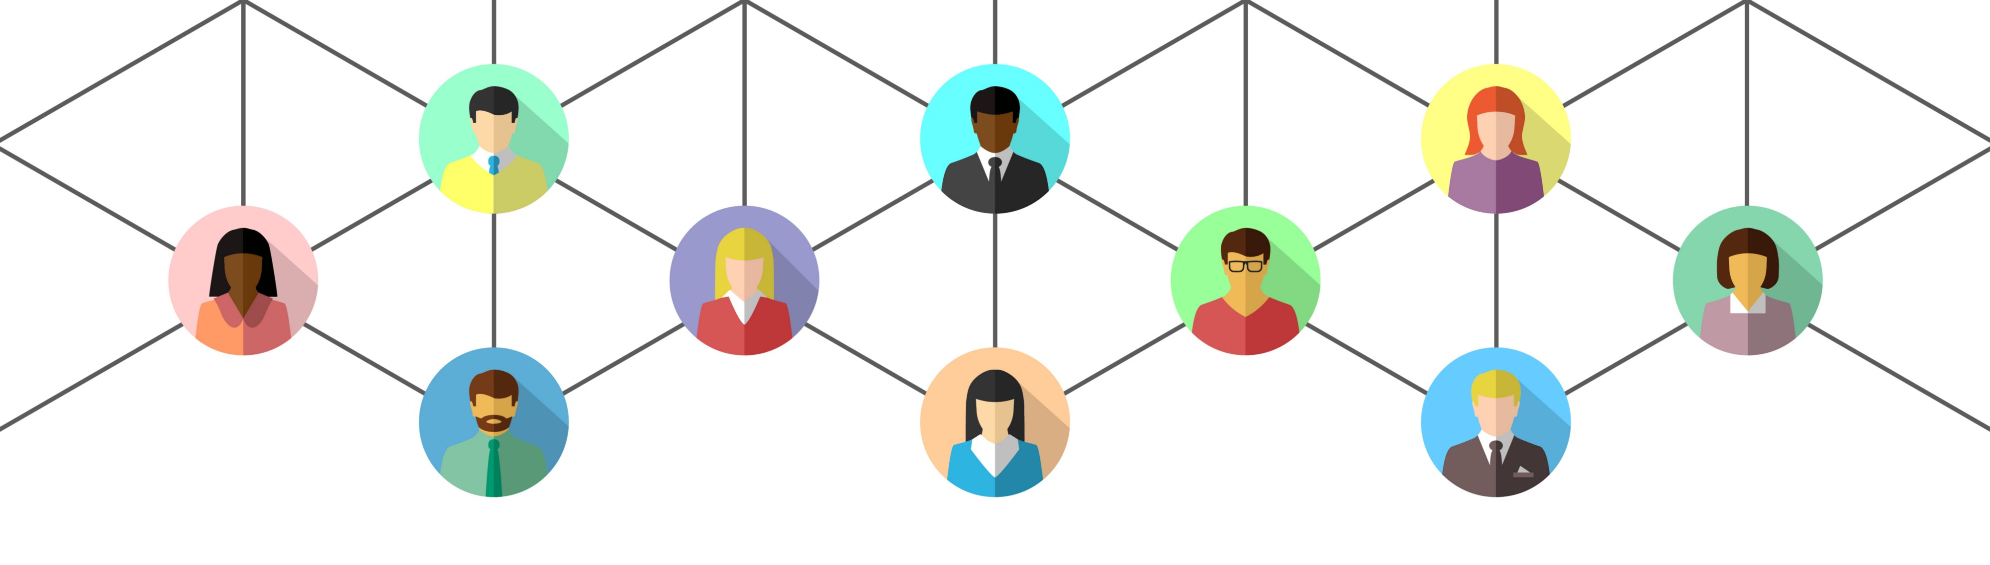
Virtual Facilitation Toolbox: part 4
Creative uses of breakout rooms
Notes:
12.03

Slide 2

What we will cover today
- facilitation methods using breakout rooms
- how and when to use them
- Q&A
Notes:
12.05
NB – not going to talk about how to use them, but will circulate an explainer video.
Possible but very clunky on MS Teams, can also share an explainer for that if needed.

Slide 3

Breakout room discussion
Introduce yourselves
Share your experiences of a breakout rooms at workshops and events
Notes:
12.07
6 mins

Slide 4
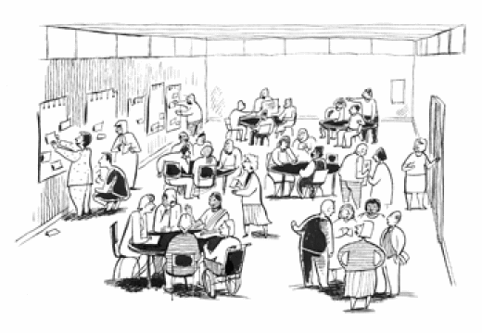
Breakout rooms
- replicating some of the ways we use space at events
- what changes from in person
Notes:
12.13
Design – give people longer than you think!
Participants – good way to get people engaged, camera on, “you have not arrived until you have spoken”
Accessibility – ask in the chat. Social anxiety, tech barriers, joining on phones

Slide 5
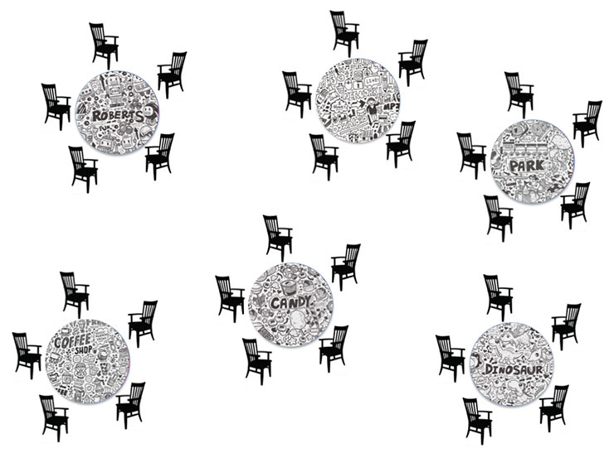
Breakout rooms

Slide 6
Three uses of breakout rooms:
- Time to Think: creativity, power dynamics
- Liberating Structures: generating ideas, reaching consensus, decision making
- World Café: networking, large group discussion
Notes:
12.17
All work regardless of the size of the event, but used for different purposes

Slide 7
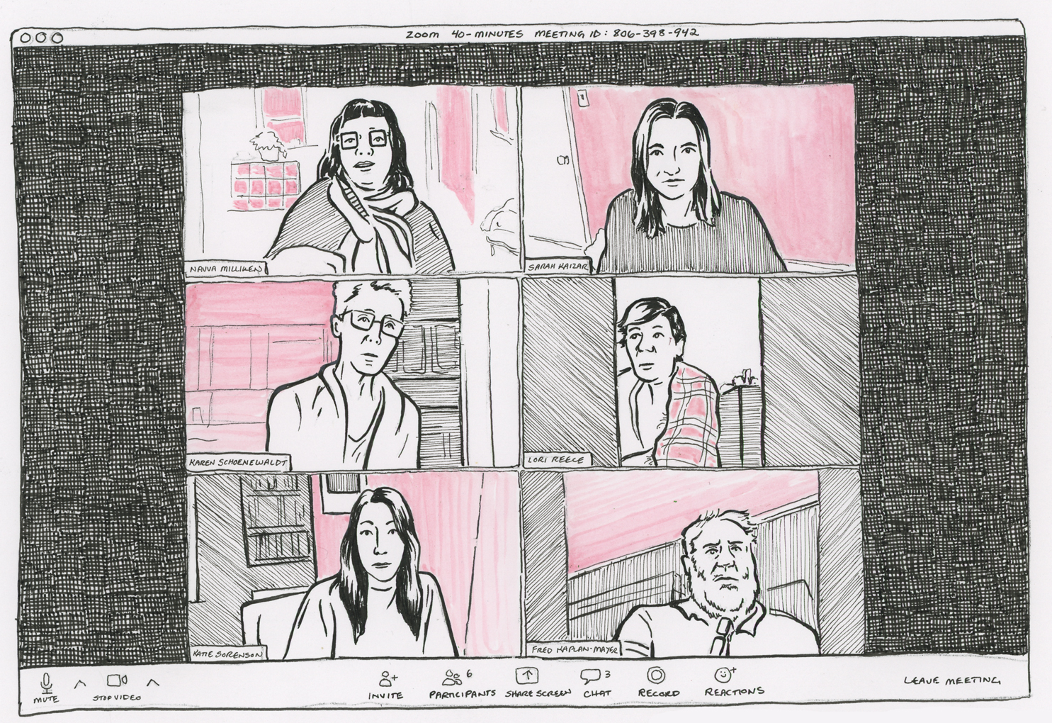
Time to Think
Thinking pairs
When to use:
Group dynamics
Creativity
2 mins per person
Notes:
12.20
The strange thing for people will be the quality of listening
Guaranteed, uninterrupted attention

Slide 8
Let’s try it out
Notes:
Let’s try it out – “what is your experience of power dynamics in virtual meetings?”
2 mins per person – we will send a broadcast message when it’s time to switch
Really focus on the quality of your listening. Nancy Kline would say interruption is an act of violence. This is a rare opportunity to listen and be heard without any fear of interruption
When back – how did you find that? Any reflections?

Slide 9

Liberating Structures
1-2-4-all
When to use:
Gather questions or ideas in large meetings
Engaging everyone at the same time
Notes:
Can be done with unlimited numbers of groups
Everyone has an opportunity to contribute

Slide 10
Silent self reflection
In the main room, invite people to keep cameras on or turn them off.
Give people 1 minute to think individually
Ask them to write down their ideas
Notes:
Silent self-reflection by individuals on a shared challenge, framed as a question (e.g., What opportunities do YOU see for making progress on this challenge? How would you handle this situation? What ideas or actions do you recommend?) 1 min.

Slide 11
Breakout rooms in pairs
Send people to breakout rooms in pairs
2+ minutes to compare their ideas and build on their self reflection
Notes:
Generate ideas in pairs, building on ideas from self-reflection. 2 min.

Slide 12
Breakout rooms in groups of 4
Combine the groups of pairs
4+ mins to share and develop their ideas, notice similarities and differences
Notes:
Share and develop ideas from your pair in foursomes (notice similarities and differences). 4 min.
You can combine breakout rooms be moving people between them – important to keep pairs together

Slide 13
Back to the main room
“What is one idea that stood out in your conversation?”
Each group shares one important idea (that hasn’t already been said)
Notes:
Ask, “What is one idea that stood out in your conversation?” Each group shares one important idea with all (repeat cycle as needed). 5 min.

Slide 14
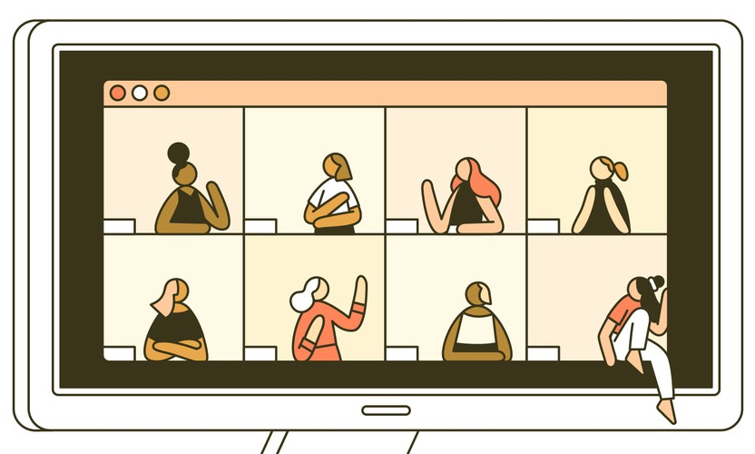
World Café
When to use:
Networking
Discussions in large groups
Notes:
Networking – large event where you want people to learn about different projects, have someone from each project or community group who will be a presenter and facilitator.
Discussions – large event where you want people to discuss ideas, i.e. community conversations. Have one facilitator per 4 people.

Slide 15
Networking
Breakout rooms of 6-8 people PLUS a presenter
5 mins sharing, then 5+ mins discussion and questions
Rotate the presenters, group stays the same
Notes:
You will need to know rough numbers attending to know how many presenters to have
Can expand the groups if you need to
More engaging than presenting from the front
Added option – choose in advance or self selecting breakout rooms to learn about projects that interest you

Slide 16
Discussion
Breakout rooms of 4-5 people PLUS a facilitator
Facilitator leads a discussion on a question relevant to the session aims (15-20 mins)
Rotate the facilitator, next group builds on the discussion of the group who came before
Notes:
Facilitator has the same question they rotate around the rooms
Each facilitator has a different question relevant to the aims of the session OR the same question but the second time is different by building on the first group’s answers
i.e. “what is great about living round here?” could stay the same.
“What are the biggest barriers to…?”

Slide 17

  Questions?
Notes:
12.55

Slide 18
Week 4 – collaborative note taking
Week 5 – virtual facilitation clinic
Links to sign up - https://www.actiontogether.org.uk/wednesdaysweekly
Virtual Facilitation Toolbox – the series

Slide 19

www.actiontogether.org.uk
0161 339 2345 info@actiontogether.org.uk @WeActTogether

