Slide 1
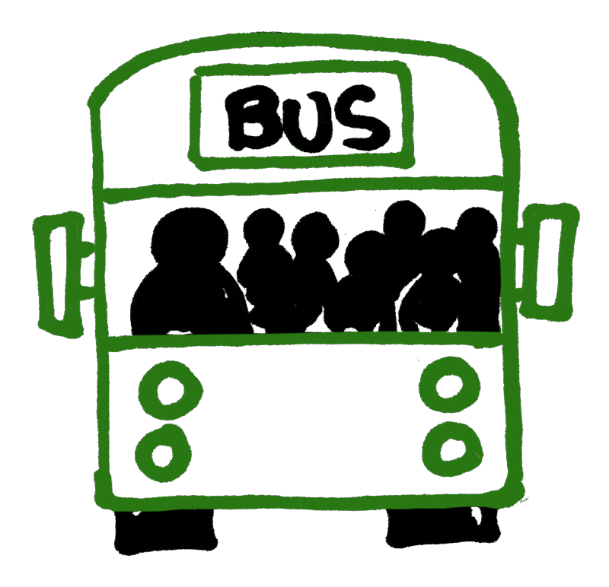
TRAVEL, SAFETY, AND CORONAVIRUS
KS3 (YR7 & YR8) DISCUSSION PACK
Updated 14/09/2020
Notes:
This discussion pack has been put together by Transport for Greater Manchester to enable teachers to facilitate a discussion with KS3 year 7-8 students during form / registration time.
The pack has been created to cover the topic of “Travel, safety, and coronavirus” and should take around ten minutes to deliver.
If students have any questions that you require assistance answering, or if you need further support on travel to school email the Sustainable Journeys team: sustainable.journeys@tfgm.com

Slide 2
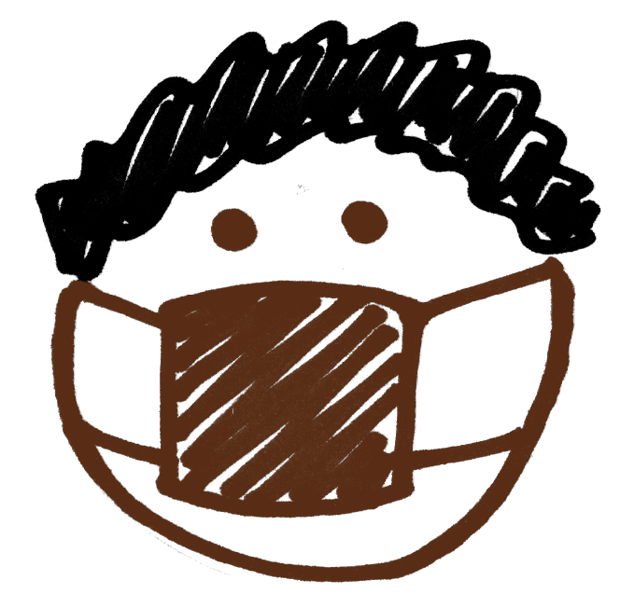
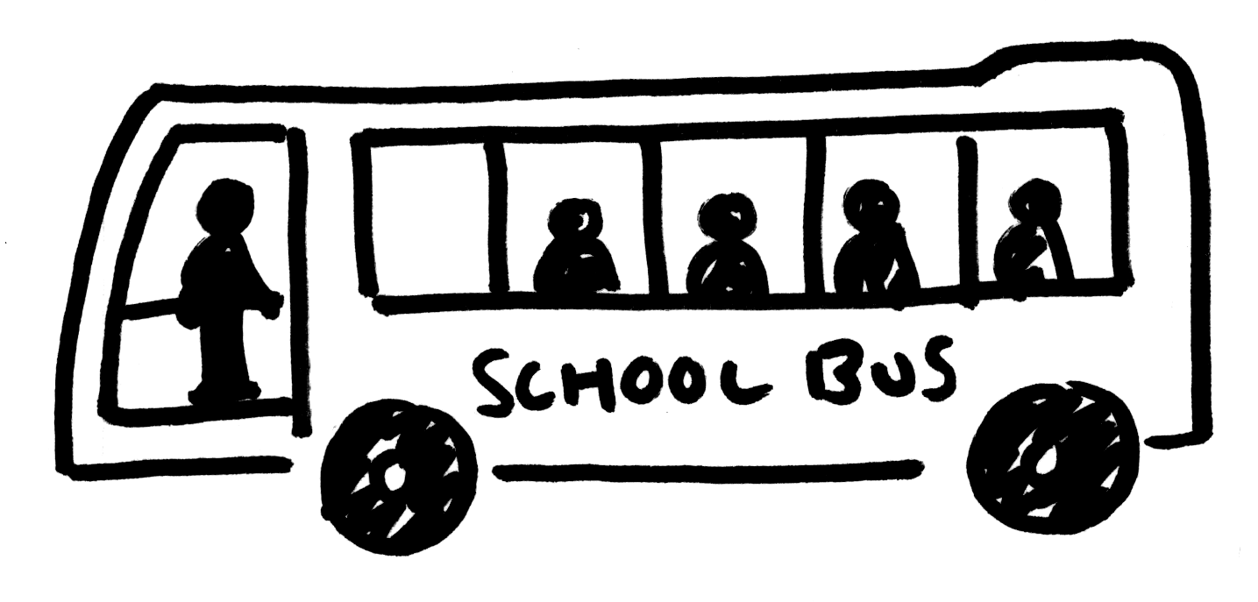
Travel, safety, and coronavirus
Learning outcomes:
Can I identify different ways of travelling in Greater Manchester?
Can I discuss how coronavirus has impacted how we travel?
Can I better understand how to keep safe when travelling?
Notes:
Aim:
To help students become better able to understand how to travel safely in Greater Manchester.
Learning outcomes:
To identify how coronavirus has impacted how we choose to travel;
To discuss how to keep safe when travelling;
To better understand the new safety rules.

Slide 3
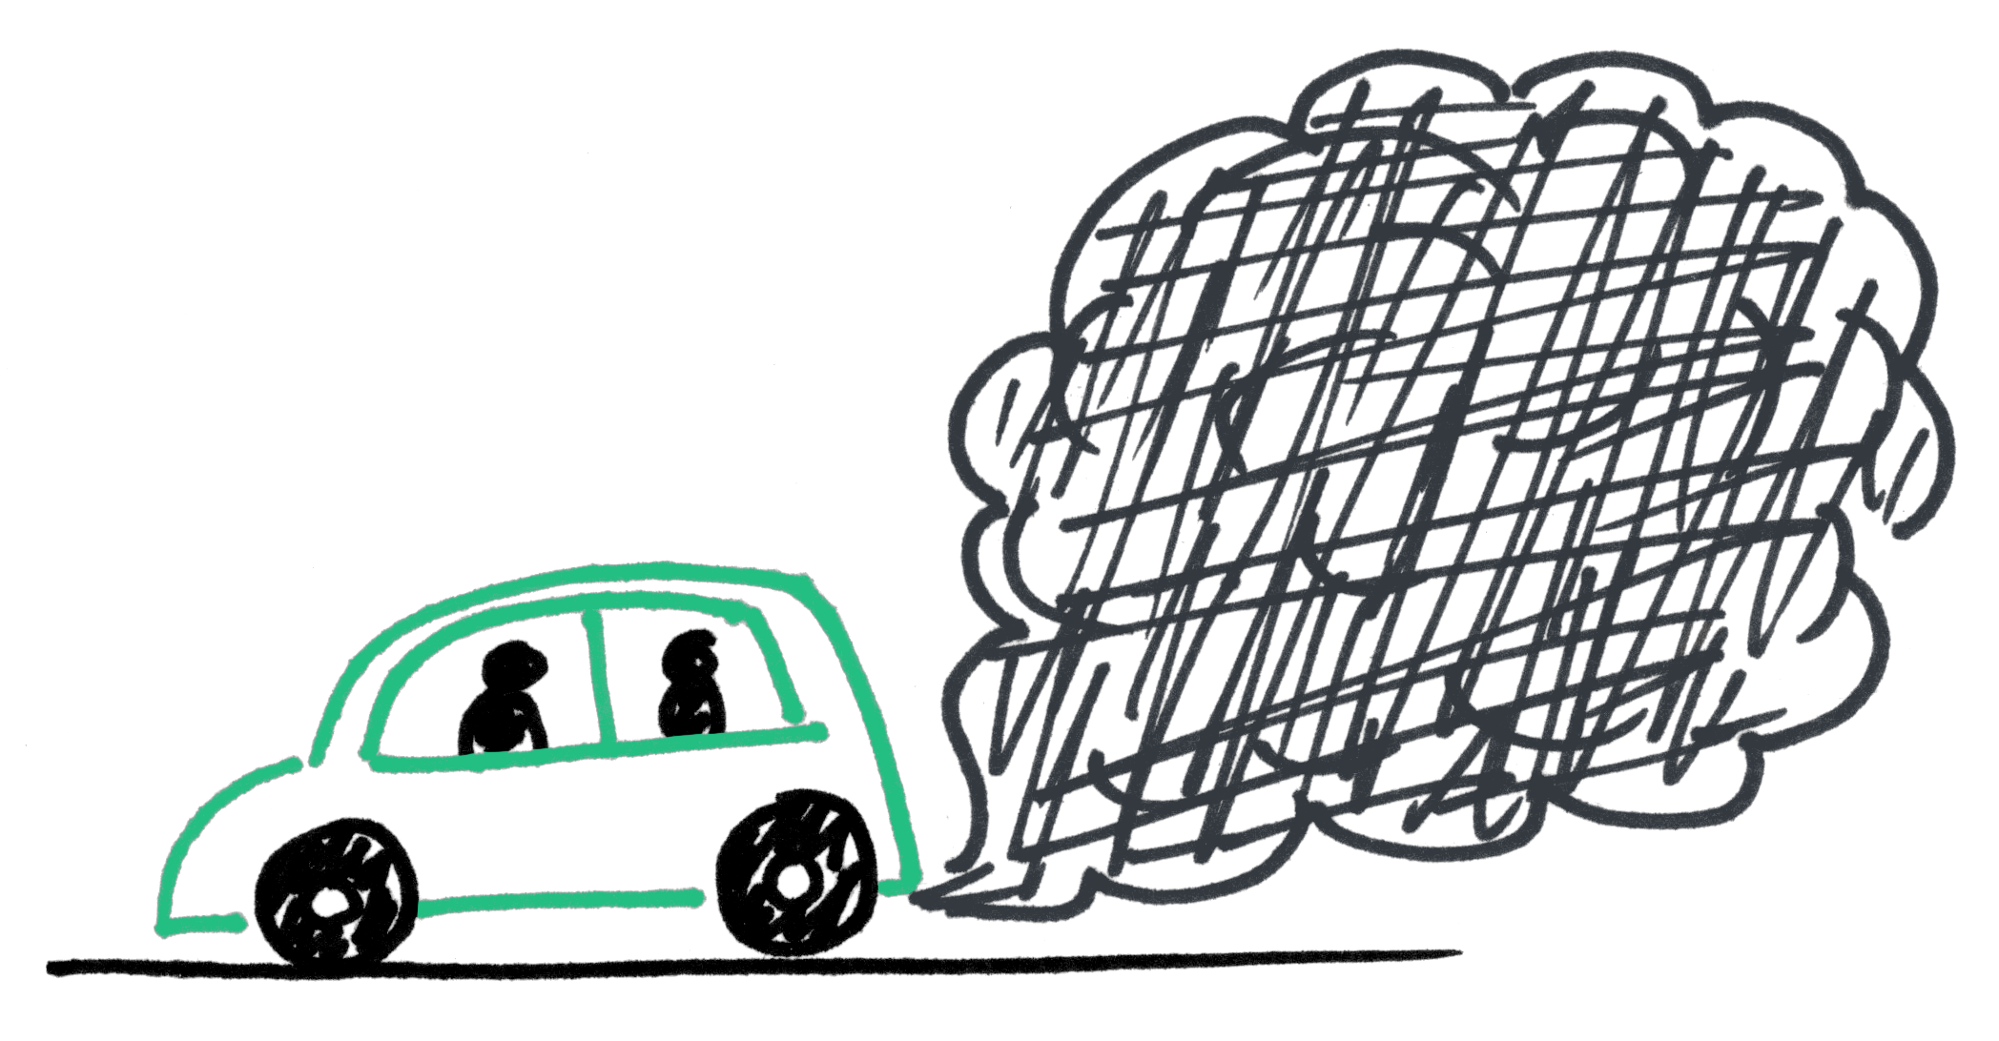
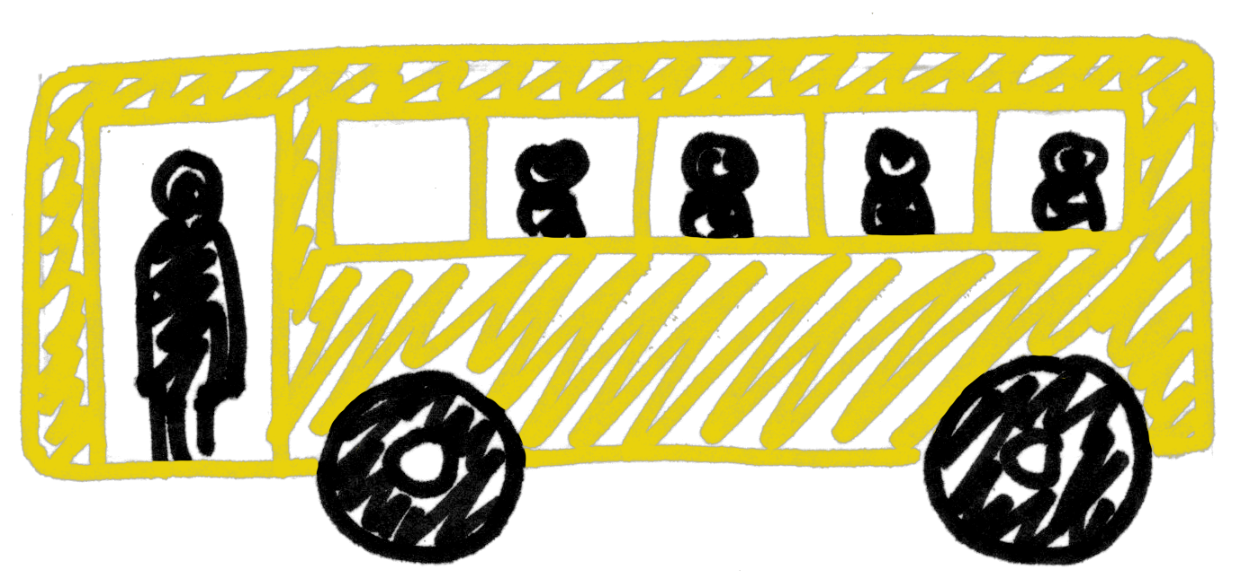
Travelling in Greater Manchester
What do you think are the most popular ways to travel around Greater Manchester - and why?
1.7%
7%
57%
1%
29%
2.2%
Notes:
Learning objective one: to identify different ways of travelling in Greater Manchester
Knowledge check: Ask students if know what “Greater Manchester” is. Clarify that England is made up of lots of counties, Greater Manchester is the name of the county that we live in.
Facilitate a classroom discussion by asking students to:
List which they think are the most popular ways to travel in Greater Manchester – ask them to give a reason why (e.g. car – because it is fast / walking – because it is free).
They are:
Car or van driver or passenger 57%
Walk 29%
Bus / minibus / coach 7%
Bicycle 2.2%
Metrolink 1.7%
Train 1%
For more information see: https://tfgm.com/TRADS

Slide 4
Coronavirus and travel
How has the way we travel changed because of coronavirus?
Think about…
Did you start travelling a new way during lockdown?
What changes have you seen in how your family and friends travel?
Let’s share our ideas
Notes:
Learning objective two: to identify how coronavirus has impacted on how we choose to travel.
Facilitate a classroom discussion with students by asking them:
To consider how coronavirus has impacted on the way we travel.
Some things that students might identify:
They could not travel during lockdown
Families might have started walking or cycling to the shops
They have changed the routes they use so they are more enjoyable
They have had to rearrange a holiday or family trip
Prompt questions if required:
Have you started travelling to school or the shops in a new way?
(If school is using bubbles) Have you had to change who you travel with – perhaps because you are now in different bubbles?
(If school is implementing staggered start times) What has changed about the time you come to school?

Slide 5
How to keep safe when travelling
What do we already know about how to keep safe when travelling?
There are some new safety rules to help you keep safe from coronavirus - do you know what these are?
1. Keep your
distance
2. Wash your
hands
Avoid using earbuds or wearing headphones
You need to be able to hear approaching vehicles and be aware of your surroundings.
3. Wear a face
covering
4. Use contactless
or correct fare
Notes:
Learning objective three: to discuss how to keep safe when travelling
Ask students what they know about how to stay safe when travelling. Some might identify the following:
When walking – stop look and listen before crossing the road
All the time – not being distracted by phones / earbuds
When cycling – wear a helmet
When in the car – wear a seatbelt
Tell students that there are some new rules to keep them safe from coronavirus when travelling. Ask students if they know what they are.
All of the new rules are appropriate for KS3 students:
Keep your distance from other passengers where possible
Clean your hands regularly
Wear a face covering on-board and in stations and interchanges, unless you’re under 11 or are exempt for another reason
Use contactless payment or exact change only
TfGM video on how to stay say on the network: https://www.youtube.com/watch?v=_A_GETGp8jM
TfGM video on how to stay safe when travelling to school: https://www.youtube.com/watch?v=wuu2dCpXzTk
How to make a facemask: See attached Government guidance

Slide 6
Coronavirus travel rules – why?
In what way do you think they stop the spread of coronavirus?
What else is happening to make public transport travel safe?
Notes:
Learning objective three: To better understand the implementation of new safety rules.
Facilitate a classroom discussion with students to identify why the new rules have been brought in.
Some ways that students might identify are:
To reduce infection spreading through touching surfaces – hand to surface contact
To reduce infection spreading through droplets in air – from mouth and nose
Prompt questions if required:
What does using hand sanitiser do? (answer: kills off most germs, not a substitute for good hand washing!)
What does using a face mask do? (answer: wearing a face mask does not protect ourselves, it protects others from our germs!)
Continue the classroom discussion by:
Asking students what else would help keep us safe when travelling
Steer students to identify that TfGM and public transport operators have put more measures in place to help you travel safely, including:
Rigorous anti-viral cleaning regime in place at bus stations and interchanges
Installed hand sanitiser dispensers for customers at interchanges
Operators are cleaning buses, trams and trains more regularly
Both TfGM and operators have introduced measures to support social distancing (e.g. extra services and signage)

Slide 7
Travel, safety, and coronavirus - a recap
Learning outcomes:
Can I identify different ways of travelling in Greater Manchester?
Can I discuss how coronavirus has impacted how we travel?
Can I better understand how to keep safe when travelling?
Notes:
Bring the session to a close and recap the main points from each learning objective.
Learning outcomes:
To identify how coronavirus has impacted how we choose to travel; (the number of journeys we take may have reduced, the way we choose to travel might have changed);
Prompt question if required – ask students to think about how many journeys they did when in and out of lockdown.
To discuss how to keep safe when travelling; (wash hands, keep distance, face covering, contactless / correct change);
Prompt question if required – ask what are the new safety rules relating to coronavirus.
To better understand the implementation of new safety rules; (reduce infection spreading through droplets in air and on surfaces).
Prompt question if required – ask how the new safety rules stop the spread of coronavirus.
Ask students to put their hand up if they feel that they better understand how to travel safely in Greater Manchester.
If students have any questions that you require assistance answering, or if you need further support on travel to school email the Sustainable Journeys team: sustainable.journeys@tfgm.com

